Slide 1


K.RAMAKRISHNAN COLLEGE OF TECHNOLOGY
(AUTONOMOUS), TRICHY.
DEPARTMENT OF
COMPUTER SCIENCE AND ENGINEERING
20CS5501 DESIGN PROJECT-1
Batch No. : 20
Date : 07.12.2024

Slide 2
DRIVER DROWSINESS DETECTION USING DEEP LEARNING
Guided by Team
Mrs. M. Mathumathi ,M.E., Sham josephraj W (811722104140)
Assistant Professor, CSE Seshanth B (811722104137)
Yogesh waran T K (811722104189)

Slide 3
OBJECTIVE OF THE PROJECT
Build a system that uses deep learning to monitor driver alertness in real-time by analyzing facial features like eye closure, head movement, and expressions
Develop a solution to detect driver drowsiness early, preventing accidents caused by fatigue through timely warnings.
Pave the way for integrating advanced driver assistance systems (ADAS) and intelligent vehicle technologies, contributing to the development of safer, more autonomous transportation systems in the future.
Train the deep learning model on a diverse dataset, enabling it to accurately identify signs of driver drowsiness and provide timely alerts or interventions before an accident occurs.

Slide 4
ABSTRACT
Driver drowsiness is a critical factor contributing to road accidents.This research proposes a novel approach driver drowsiness detection using deep learning techniques.A convolutional neural network(CNN) is employed to analyze facial features and monitor driver behavior in real-time.
The system process input from in-vehicle cameras,extracting relevant features such as eye closure,head movement and facial expressions.By training the model on a diverse dataset,it learns to accurately classify the driver’s alertness level.The proposed method demonstrates promising results in accurately identifying drowsy states, providing a proactive mechanism for timely intervention.

Slide 5
LITERATURE SURVEY
TITLE OF THE PAPER | AUTHOR (S) | PUBLISHER | PAPER GIST | TECHNOLOGY USED
“Driver Drowsiness Detection Using Deep Learning Techniques | Robert Brown, Ph.D. (Department of Artificial Intelligence, DEF University) | IEEE (Institute of Electrical and Electronics Engineers) In 2023 | Convolutional Neural Networks (CNNs) and Long Short-Term Memory (LSTM) networks, to analyze facial expressions, eye movements, and head gestures to identify drowsiness indicators | Camera + OpenCV/Dlib: Real-time facial feature tracking.CNN: For analyzing images and detecting facial expressions related to drowsiness.LSTM: For processing sequences of data (e.g., eye blinks, head movements) over time
Journal of Transportation Safety & Security | Hannah Lee, M.Sc. (Department of Transportation Engineering, GHI University) | Taylor & Francis Group In 2021 | The system is designed toboth accurate and computationally efficient,operating in real-world driving conditions. | Face and Eye Detection Time-Series Analysis Alert Generation

Slide 6
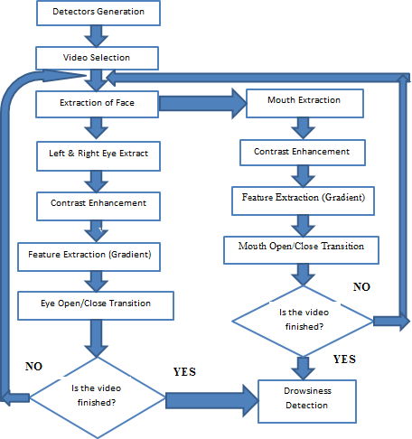
PROPOSED SYSTEM ARCHITECTURE

Slide 7
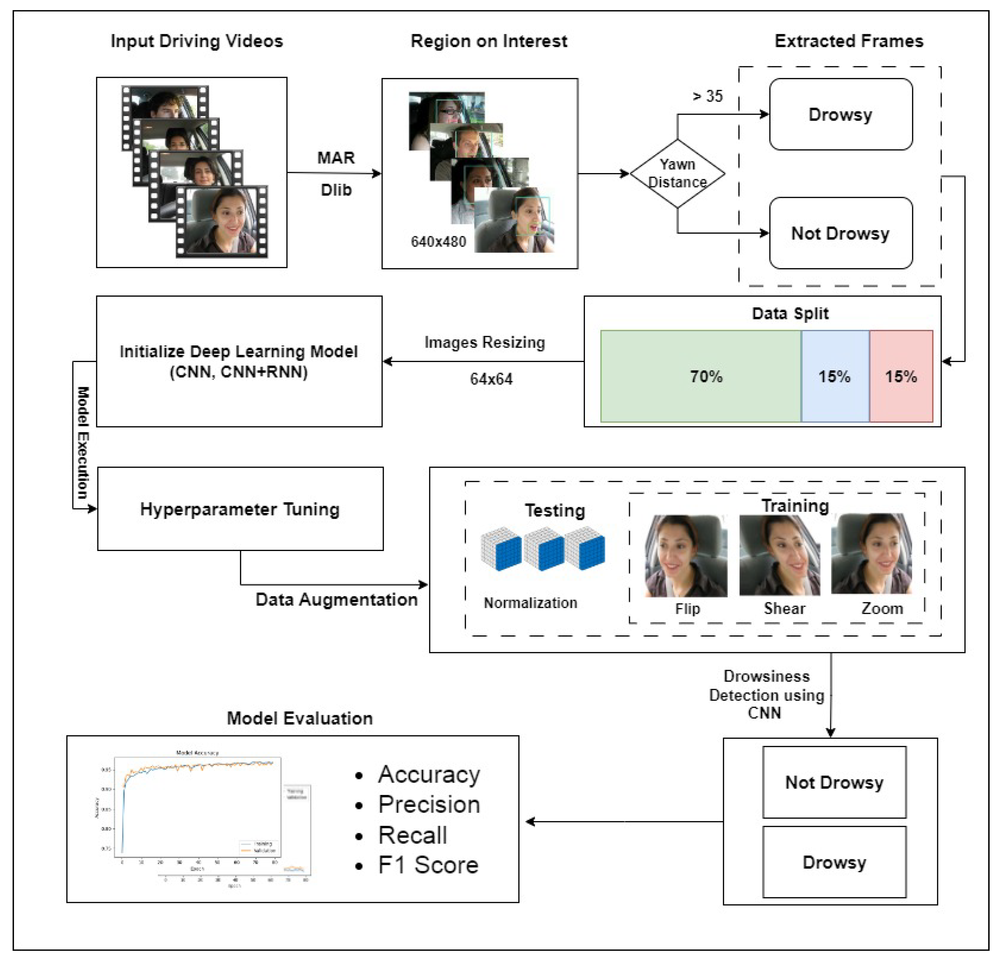
EXISTING SYSTEM ARCHITECTURE

Slide 8
SOFTWARE AND HARDWARE REQUIREMENTS
HARDWARE
SOFTWARE
Processor: A high-performance processor with multiple cores to handle complex calculations and data processing tasks efficiently.
Memory (RAM): Sufficient RAM to ensure smooth operation and support for multiple users and applications simultaneously.
In-Vehicle Camera: Minimum 720p for accurate facial feature extraction.
Power Supply: A reliable power supply unit to ensure consistent power delivery and prevent data loss during power outages.
Operating System: A stable and secure operating system, such as Linux or Windows Server, to manage system resources and provide a platform for running applications.
Programming Languages: Python 3.8 or higher for implementing and deploying models.OpenCV for real-time video processing and facial feature detection.
Data Processing Algorithms: Advanced algorithms and machine learning models to analyze customer behavior, track transactions, and predict future customer lifetime values.
Deep Learning Frameworks:Version 2.x for designing and training CNN models.

Slide 9
MODULES
Data Collection and Preprocessing Module
Feature Extraction Module
Deep Learning Model (CNN)
Drowsiness Classification and Alert Generation Module
Real-Time Monitoring and Feedback Module

Slide 10
SUMMARY OF MODULE-1 Data Collection and Preprocessing Module
In-Vehicle A camera is installed inside the vehicle to capture the driver’s face and monitor behavior such as eye closure, head movement, and facial expressions. Data Preprocessing This involves cleaning the data, including resizing images, normalization, and converting to grayscale (if needed). Face detection techniques are applied to locate the region of interest (ROI) that focuses on the driver's face. Data Augmentation To improve the model's robustness, augmentation techniques such as rotation, flipping, and changes in brightness can be applied to simulate diverse real-world conditions

Slide 11
SUMMARY OF MODULE-2 Feature Extraction Module
Eye Closure Detection Using techniques like Eye Aspect Ratio (EAR) to detect when the eyes are closed for extended periods, a strong indicator of drowsiness. Head Movement Monitoring Analyze the head's position and movement. For example, head tilting or nodding can be signs of fatigue. Facial Expression Recognition Identify changes in facial expressions like yawning, frowning, or reduced alertness, which are also indicators of drowsiness.

Slide 12
SUMMARY OF MODULE-3 Deep Learning Module (CNN)
Convolutional Neural Network (CNN) is the primary model architecture for processing facial features in real-time. CNN is capable of learning from data and classifying the driver's alertness into different states such as alert, drowsy, or sleepy. the model is trained on a large dataset of labeled images, including various conditions like different facial expressions, head poses, and lighting conditions to ensure generalization. Use pre-trained models (e.g., VGG, ResNet) and fine-tune them on the driver dataset to improve performance with fewer data and faster training.

Slide 13
SUMMARY OF MODULE-4 Drowsiness Classification and Alert Generation Module
Alert System:
Based on the model’s output, the system classifies the driver's alertness level. If drowsiness is detected, an alert is triggered (e.g., visual, audio, or vibration-based warning).
Thresholds and Proactive Interventions:
Define thresholds for drowsiness detection (e.g., if the eyes are closed for more than a certain percentage of time). If drowsiness exceeds these thresholds, the system can suggest a break, activate lane-keeping assistance, or initiate other safety measures.

Slide 14
SUMMARY OF MODULE-5 Real Time Monitoring and Feedback Module
Continuous Video Feed:
The system continuously captures and processes video from the in-vehicle camera to monitor the driver’s state at all times.
Real-Time Feedback:
Provide instant feedback (e.g., visual cues on the dashboard or through an app) to warn the driver when drowsiness is detected.
Data Logging:
Record driver’s alertness states for analysis or future training data, which could be used for further refinement of the system.

Slide 15
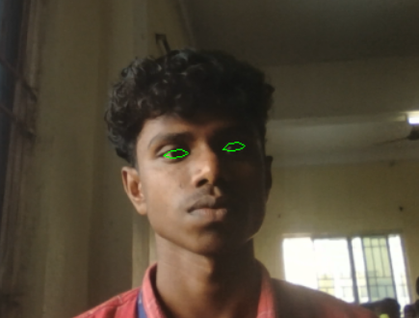
RESULTS AND DISCUSSION

Slide 16
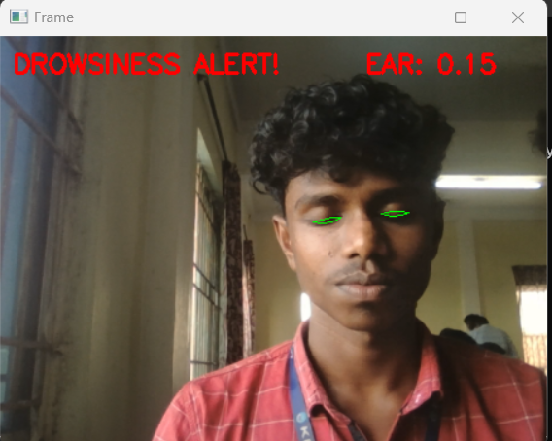
RESULTS AND DISCUSSION

Slide 17
CONCLUSION
The Driver Drowsiness Detection System developed in this project provides a smart solution to improve road safety by using deep learning to monitor driver alertness in real-time. By analyzing facial features like eye closure, head movement, and facial expressions, the system can detect signs of drowsiness and provide warnings to the driver.
This project highlights the potential of artificial intelligence in creating safer driving environments. With continued improvements, this system could become an important part of Driver Assistance Systems in vehicles, helping to reduce accidents and save lives. Overall, the system is a promising step towards making driving safer by addressing the serious issue of driver fatigue.

Slide 18
THANK YOU

